Slide 1
Lecture 9:
SDLC Models
Mia Mohammad Imran

Slide 2
Today’s Objectives
Going back to SDLC: major SDLC models
Understand when to use each model
Identify strengths and weaknesses
Learn to choose the right model for your project

Slide 3






Teams and Roles
Collaboration!
Customer/Stakeholders
Project Manager
Software Architect
Software Designer
Developer
Tester
etc
Software Architect
Customer/Stakeholders
Project Manager
Programmer
Software Designer
Software Tester

Slide 4
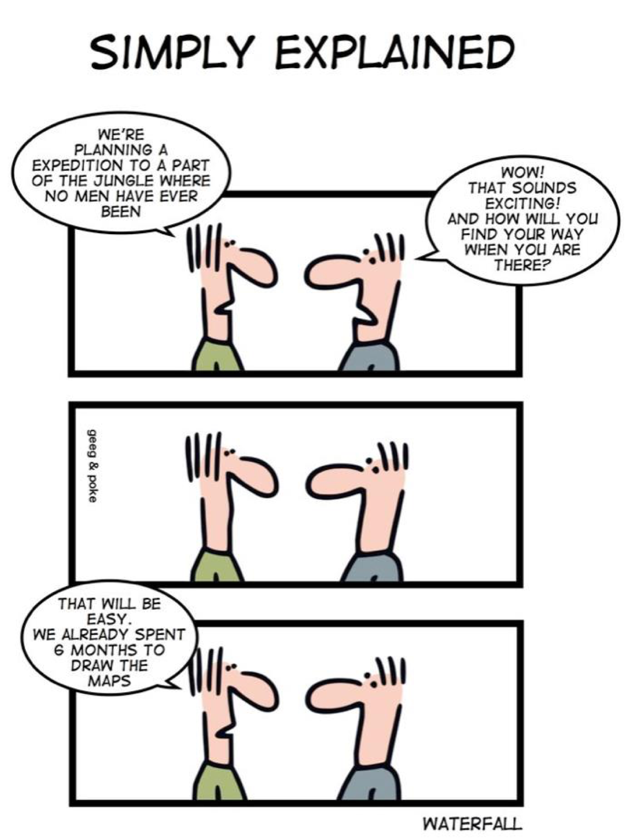
Waterfall Model

Slide 5
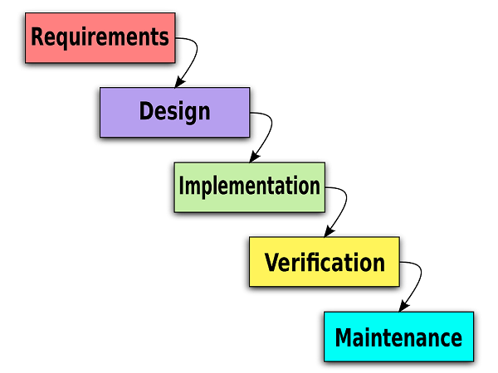
Waterfall Model (1968)
It’s like a disciplined martial artist! Waterfall follows:
Strict discipline
Sequential moves
Perfect form
No shortcuts

Slide 6
Waterfall Model: Key Characteristics
Linear progression
Clear documentation
Structured phases
Formal sign-offs

Slide 7
Waterfall Model: When to Use
Clear, unchanging requirements
Well-understood technology
Short projects
Regulatory compliance needs

Slide 8
Waterfall Model: Real World Example
NASA Space Shuttle Software
Zero-defect requirement
Life-critical systems
Extensive documentation
Rigorous testing

Slide 9
You're leading a School Management System using the Waterfall model.
Initial Setup:
8-month project
$200K budget
Requirements gathered from principal (teachers on summer break)
Modern UI design approved without teacher input
4 months into development:
Government announces new compliance requirements
School wants additional features
Teachers return and hate the UI
State database integration needed

Slide 10
Question: What would You Do?
Continue with original plan and documentation?
Return to requirements phase and restart?
Try to modify current phase while maintaining Waterfall structure?
Propose a hybrid solution within Waterfall framework?

Slide 11
Understanding the Trade-offs
Option 1: Continue Original Plan
✅ Maintains timeline and documentation integrity
✅ Preserves budget allocation
❌ Results in unusable system for teachers
❌ Fails compliance requirements
Impact: Project failed successfully!

Slide 12
Understanding the Trade-offs
Option 2: Return to Requirements
✅ Addresses all stakeholder needs properly
✅ Ensures compliance and integration
❌ Doubles project timeline
❌ Exceeds budget by 80%
Impact: Better product, but missed market window

Slide 13
Understanding the Trade-offs
Option 3: Modify Current Phase
✅ Partially addresses new requirements
✅ Minimal timeline impact
❌ Breaks Waterfall's sequential nature
❌ Creates documentation inconsistencies
Impact: Compromised quality and structure

Slide 14
Understanding the Trade-offs
Option 4: Hybrid Solution
✅ Maintains some Waterfall structure
✅ Allows for critical changes
❌ Increases project complexity
❌ Creates management challenges
Impact: Balance of adaptation and control

Slide 15
Understanding the Trade-offs
Key Lessons:
Early stakeholder involvement is crucial
Build flexibility into documentation
Plan for change in timeline/budget
Consider phased deployment
Document assumptions explicitly
Remember: In real projects, early prevention of these issues is the best solution!
That means Waterfall is destined to fail!

Slide 16
Boehm’s First Law
"Errors are most frequent during requirements and design activities and are the more expensive the later they are removed."
Earlier phases have more errors
Cost of fixing increases over time
Prevention is better than cure
Early detection saves resources

Slide 17
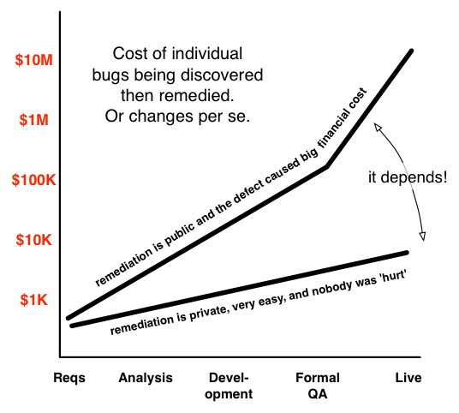
Boehm’s First Law

Slide 18
Boehm’s First Law
“They estimated that a bug found during TDD costs $5 to fix, which surges to $50 for tests during a full build and $500 during an integration test. It goes to $5000 during a system test. Fixing bugs earlier would save them an estimated $160M per year.”
Mark Striebeck, Google, 2009
https://gojko.net/2009/12/07/improving-testing-practices-at-google/

Slide 19
How Boehm's Law Affects Waterfall
Front-loaded requirements gathering
Extensive early documentation
High cost of late changes
Sequential progression magnifies issues

Slide 20
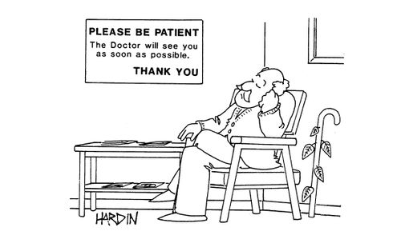
What Are the Other Major Pitfall of Waterfall?
Long delivery times
  Customer must have patience
  Customer sees product only at end

Slide 21
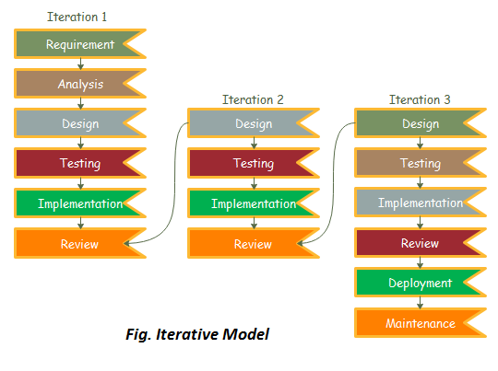
Iterative Development Models
Think of building a LEGO castle:
Start with a basic structure
Add features piece by piece
Improve based on feedback
Keep building until complete

Slide 22
Waterfall vs Iterative
Waterfall:
Building a house in one go
No moving in until complete
Changes are expensive
Iterative:
Building a house room by room
Can live while building
Changes between rooms possible

Slide 23
Iterative Models: Key Features
Requirements → Design → Code → Test
Multiple Cycles
Each cycle adds features
Learn from previous cycles
Growing Product
Starts with core features
Adds functionality gradually
Regular Feedback
User input between cycles
Reduces risk/Better user satisfaction

Slide 24
Iterative Models: Challenges to Consider
Management Overhead
More meetings
Regular planning
Documentation
Multiple updates
Change tracking/Version control
Resource Management:
Team availability
Frequent testing
Budget control

Slide 25
Iterative Models: When to Use
Good for:
Unclear requirements
New technology
Complex systems
Regular feedback needed
Maybe not:
Simple, clear projects
Fixed requirements
Critical systems
Limited user access

Slide 26

Real World Example
Microsoft Windows Operating System
Started with basic OS
Added features gradually
Regular updates
User feedback incorporation
Continuous improvement

Slide 27
The Street-Smart Approach: Agile Model
Snowbird, Utah - February 2001
17 software developers met to discuss:
Need for better development methods
Focus on delivering value
Importance of adaptation
Result: The Agile Manifesto! 📜
https://agilemanifesto.org/

Slide 28
The Agile Manifesto: Core Values
Individuals and interactions > processes and tools
Working software > comprehensive documentation
Customer collaboration > contract negotiation
Responding to change > following a plan
“While there is value in the items on the right, we value the items on the left more”

Slide 29
12 Agile Principles
https://agilemanifesto.org/principles.html
Customer Satisfaction
  Early and continuous delivery
Welcome Change
  Even late in development
  Competitive advantage
Frequent Delivery
  Shorter timescales
Working Software
  Primary measure of progress
  Demo > Documentation
Sustainable Development
  Maintain constant pace
  Long-term sustainability
Technical Excellence
  Continuous attention
  Good design enhances agility
Business & Developers Together
  Daily collaboration
Trust & Support
  Build projects around motivated people
  Provide environment and support
Face-to-Face Communication
  Most efficient and effective
Simplicity
  Maximize work not done
  Essential = Art
Self-organizing Teams
  Best architectures
  Best designs
Regular Reflection
  Team adjusts behavior
  Increase effectiveness

Slide 30
Key Agile Concepts
Iterative Development
  Short cycles
  Regular feedback
  Continuous improvement
User Stories
  Customer perspective
  Business value
  Acceptance criteria
Daily Stand-ups
  Quick updates
  Obstacle removal
  Team synchronization

Slide 31
Agile SDLC Phases
Inception: Form teams, establish requirements.
Concept: Identify project vision and feasibility.
Iteration/Increment: Develop in short sprints.
Release: Deploy working software.
Maintenance: Continuous improvements and fixes.
Retirement: End of product life cycle.

Slide 32
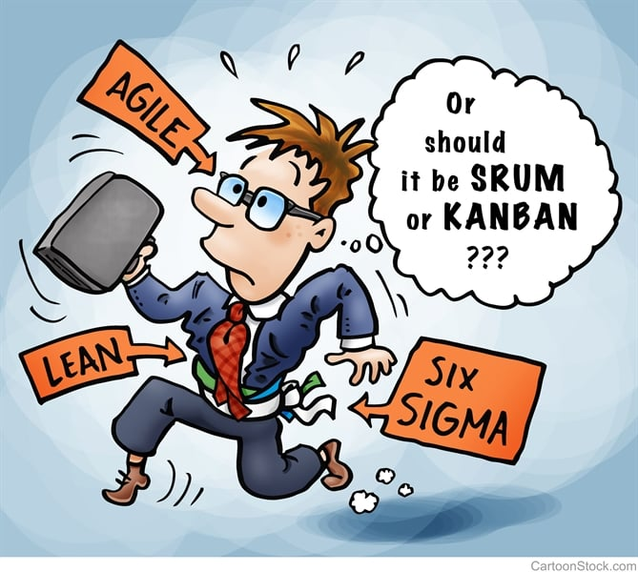
Common Agile Frameworks
Scrum
  Sprints, Product Backlog, Scrum Master
Kanban
  Visual workflow, WIP limits, Continuous flow
XP (Extreme Programming)
  Pair programming, Test-driven development, Continuous integration

Slide 33
Real World Example
PayPal, Spotify, Toyota, JP Morgan, Chase, FitBit and more!
Spotify Agile Model:
  https://www.atlassian.com/agile/agile-at-scale/spotify
  https://productschool.com/blog/product-fundamentals/spotify-model-scaling-agile

Slide 34
Agile Anti-patterns ⚠️
Cargo Cult Agile
  Following practices blindly
  Missing the principles
Water-Scrum-Fall
  Agile in name only
  Traditional control
Sprint Marathon
  Unsustainable pace
  Team burnout

Slide 35
Extreme Programming aka XP
A version of Agile:
http://www.extremeprogramming.org/
“If a practice is good, do it often”

Slide 36
XP’s Core Values
Communication (between team and with customers)
Simplicity (in design and code)
Feedback (at many levels)
Courage (to make and implement difficult decision)

Slide 37
XP’s Fundamental Principles
Rapid feedback
Simplicity
Incremental change
Embrace change
Quality work
Directly from “core” values

Slide 38
XP’s 12 Key Practices
Planning game (small units of requirements)
Onsite customer (immediate and better feedback)
Metaphor (use one set of metaphor for design/architecture)
Simple design (just enough to cover what’s needed)
Coding standard (facilitates better communication)
Collective code ownership (peer pressure to improve code)
Pair programming (feedback and shared improvements)
Refactoring (continuous examination for duplicative design/code)
Continuous functional and unit testing (100% completion)
Small/short releases
Continuous integration (integrating of small releases)
40-hour work week (high morale and energy level)
some
recognition
of
“human”
aspects

Slide 39
Extreme Programming “Process”
Onsite Customers
Coding standards
Simple Design
Planning
Game
Pair Programming
Functional &Unit Test
Small/short
Release
System Metaphors
Continuous Integration
Refactoring
Collective Code
Ownership
Larger
Release
Adhere to 40-hour work week as much as possible ! -- sustainable pace

Slide 40
Scrum Development Process (Currently Popular)
First introduced by Takeuchi and Nonaka (Japan) in 1986, modeled after the way rugby game is played.
Ken Schwaber and Mike Beedle published a book, “Agile Software Development with Scrum,” in 2001.
It is an incremental and iterative development approach:
  Develops small “sprints,” or increments (of features) in a short cycle of about 2–3 weeks
  There are three main roles
  Product Owner who talks to and decides with users about the content of each sprint
  Scrum Master who runs the sprints
  Scrum Team of about 7–8 members who develop the sprint

Slide 41
Questions for Discussion
Where would you still choose Waterfall today?

